Slide 1
IO Basics
by
A.Harish

Slide 2

Input-output in Java

Slide 3
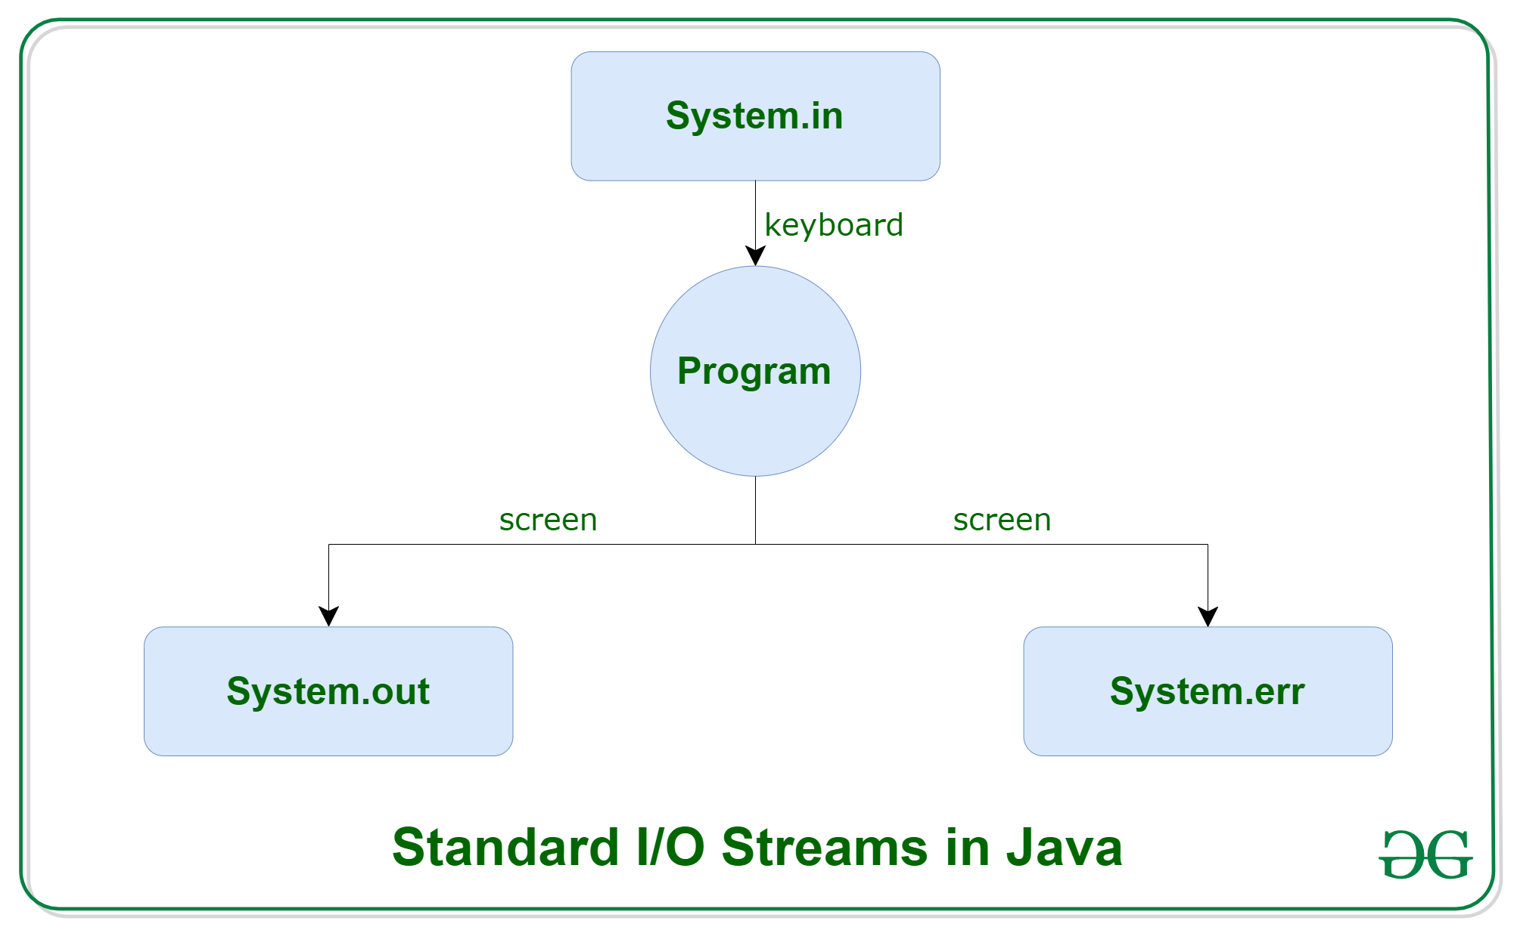
Standard IO Streams in Java

Slide 4
Types of Streams based on file Types
ByteStream
CharacterStream

Slide 5
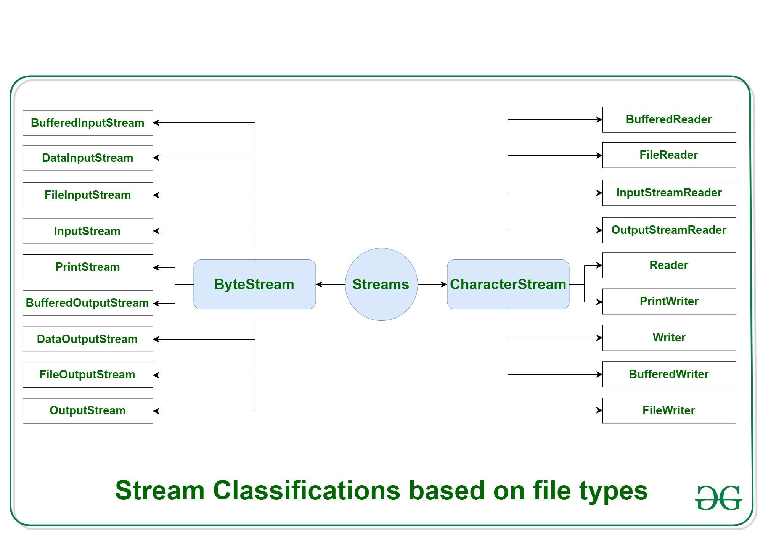

Slide 6
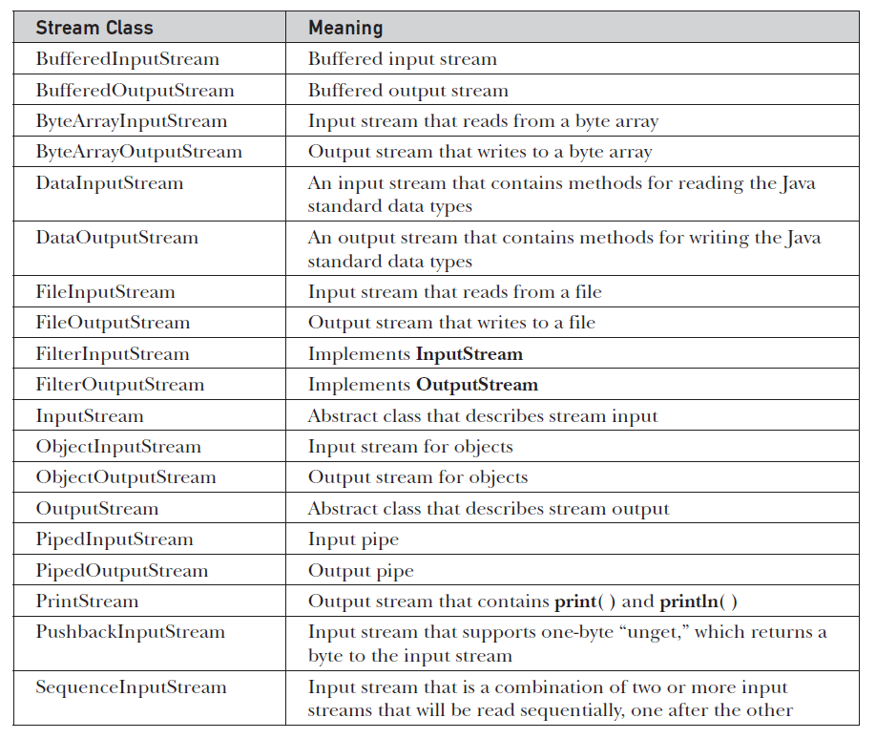

Slide 7
